Slide 1


Big Data and Analytics : Fundamentals

Slide 2
Agenda
What is Big Data?
What are the uses of Big Data?
Architecture of Big Data
Two Big Technologies in the Big Data Ecosystem
Apache Hadoop and its Usages
Apache Spark Usages

Slide 3
What is Big data
Big Data is a loosely defined term used to describe data sets so large and complex that they become awkward to work with using standard software in a tolerable elapsed time
Big data "size" is a constantly moving target, ranging from a few dozen terabytes to many petabytes of data
In the past three years, 90% of all recorded data has been generated
Every 60 seconds:
100,000 tweets
2.4 million Google searches
11 million instant messages
170 million email messages
1,800 TB of data

Slide 4
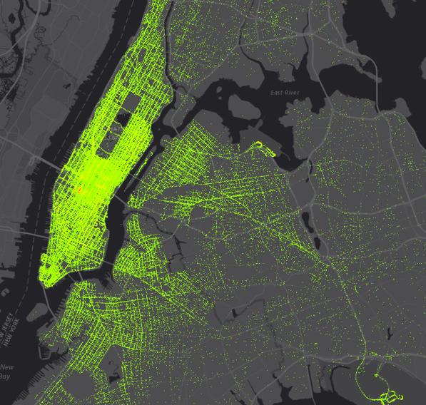
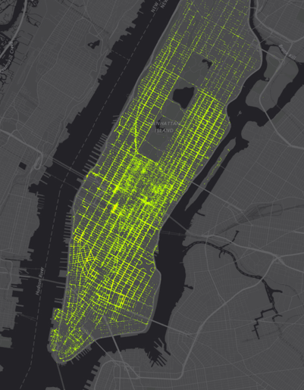
NYC Taxis Report
Manhattan Taxis

Slide 5
Big data What techniques are applied to handle it?
Data distribution – large datasets are split into smaller datasets and distributed across a collection of machines
Parallel processing – using a collection of machines to process the smaller datasets, combining the partial results together
Fault tolerance – making copies of the partitioned data to ensure that if a machine fails, the dataset can still be processed
Commodity hardware – using standard hardware that is not dependent upon exotic architectures, topologies, or data storage (e.g., RAID)
Scalability – algorithms and frameworks that can be easily scaled to run on larger collections of machines in order to address larger datasets

Slide 6
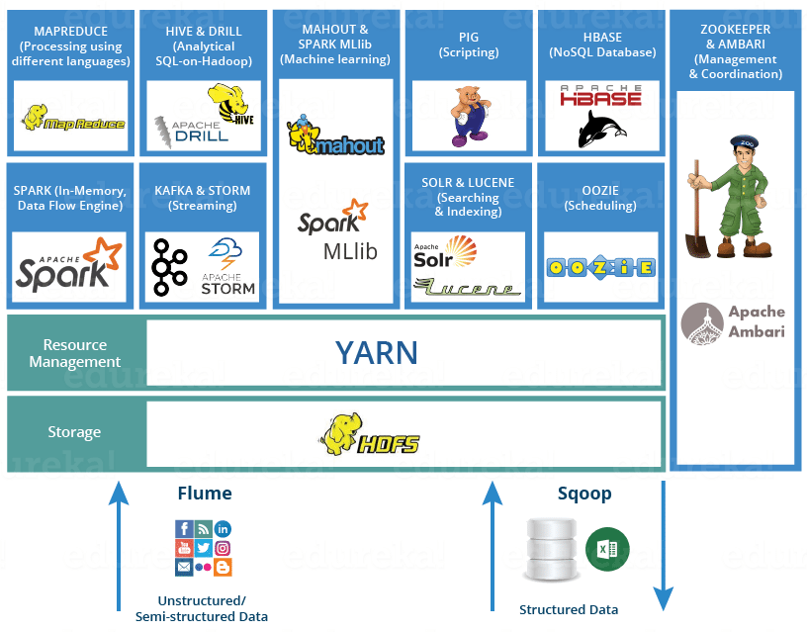
Architecture of Big Data

Slide 7
Apache Hadoop
Hadoop is a scalable open source framework for the distributed processing of extremely large data sets on clusters of commodity hardware
Maintained by the Apache Software Foundation
Assumes that hardware failures are common
Hadoop is primarily used for:
Distributed storage (HDFS)
Distributed computation (MapReduce)

Slide 8
Apache Spark
Apache Spark is a framework for real time data analytics in a distributed computing environment.
The Spark is written in Scala and was originally developed at the University of California, Berkeley.
It executes in-memory computations to increase speed of data processing over Map-Reduce.
It is 100x faster than Hadoop for large scale data processing by exploiting in-memory computations and other optimizations. Therefore, it requires high processing power than Map-Reduce.

Slide 9
Thanks for your time

